Slide 1
Product Announcements and Stock Prices
Final Project Report
By Braden Martin, Matthew Mohandiss, Jiuru Zhu

Slide 2
Motivation
Interest in business and finance.
Research the effect product announcements have on stock price.
Hope to better understand why a stock has a certain price at a given time.
Well-known events made us interested in how product announcements and customer expectations impact a stock’s price.

Slide 3
Methodology
Split work into three parts
Each group member chose a tech company to research
Individually collected and processed data
Percentage change values were calculated using the announcement day and one, three, or seven day close prices
Clustered column charts were created to compare Google, Microsoft, and Apple stock prices

Slide 4
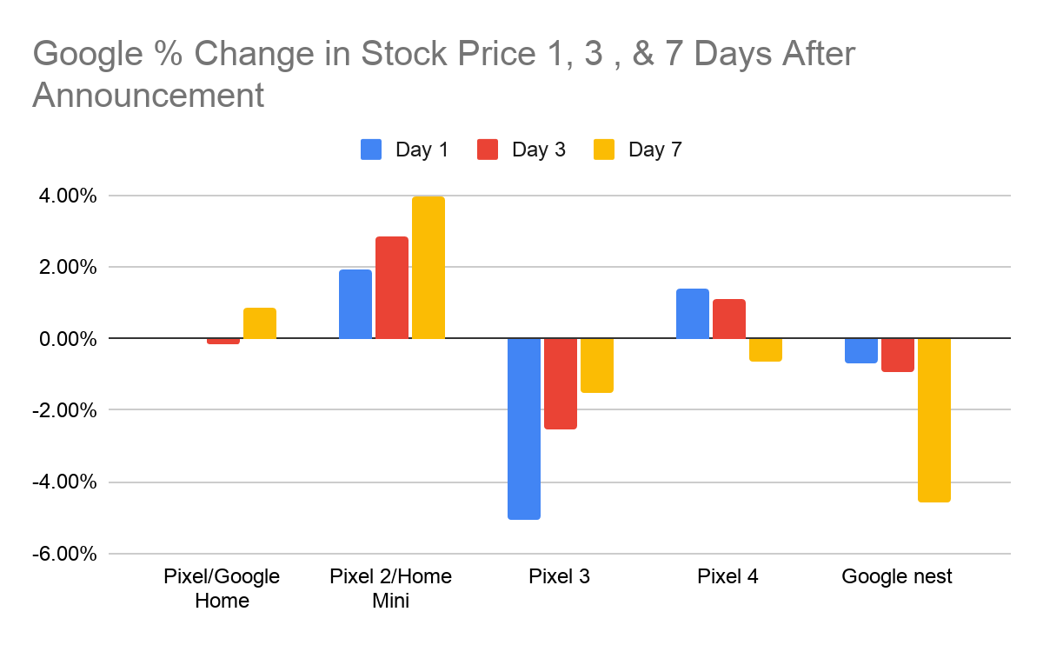
Results and Analysis
Hard to recognize a pattern or trend
Two product announcement on some days
Some of the products have an increasing trend even if it is negative
Data still not concrete enough to assume that the stock price went up because of the products’ announcement

Slide 5
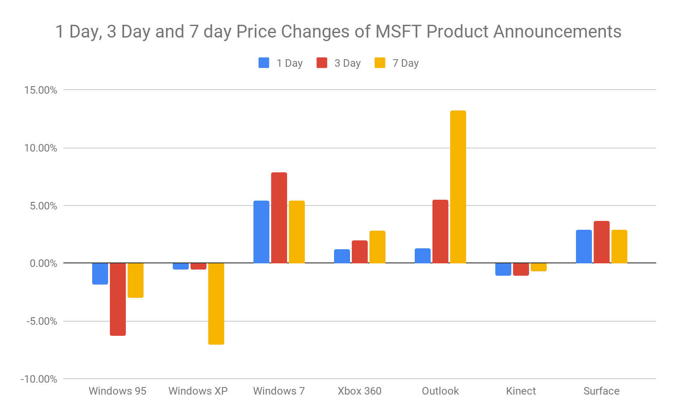
Results and Analysis continued...
Little correlation across products
Large Jump in Outlook and Windows XP 7-day
Other products saw price rebound to announcement day price
 | 1 Day | 3 Day | 7 Day
Windows 95 | -1.83% | -6.32% | -3.00%
Windows XP | -0.58% | -0.55% | -7.03%
Windows 7 | 5.38% | 7.86% | 5.38%
Xbox 360 | 1.20% | 1.96% | 2.80%
Outlook | 1.30% | 5.49% | 13.21%
Kinect | -1.07% | -1.07% | -0.74%
Surface | 2.88% | 3.65% | 2.88%
Data: https://docs.google.com/spreadsheets/d/1eAZzwHKDpt8k9QXXStrsZoaZIs8sbi7_WUMzKukI0mA/edit?usp=sharing

Slide 6
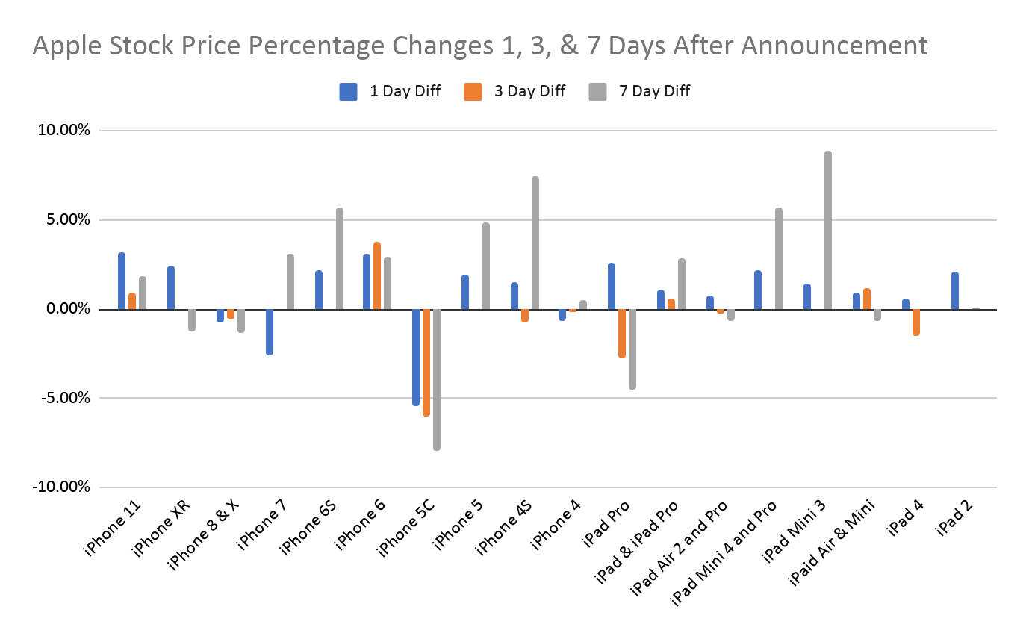
Results and Analysis Continued...
Significant variance
Largest price change typically on 1 or 7 days after announcement
7 day interval has largest increases
Displays the unpredictability of the stock market

Slide 7
Conclusion
Product announcements often lead to increase in stock price
Too much variance to guarantee a correlation between product announcements and stock price
Variance could be caused by external factors (events unrelated to product announcements).
Consumer product learn-time could impact variance

Slide 8
Issues
Missing data points
Reactive nature of stock market

Slide 9
Future Work
Studies that help isolate the events impacting a stock’s price would allow us to ensure the correlation that we do see is actually caused by the product announcement.
Study that keeps track of major negative positive events in a company’s existence would be useful in granting context to our data.
Study that defines how consumers learn about new products being announced would be useful to grant context to selected timeframe.`

Slide 10
Sources
https://infonewt.com/apple-release-patterns
https://www.kaggle.com/tarunpaparaju/apple-aapl-historical-stock-data
https://finance.yahoo.com/

